Slide 1
Academic vs Industry Positions
Which Should I Choose?
(If I Have a Choice)

Slide 2
Academic vs. Industry Jobs
Note 1: An ‘Academic Job’ is a full-time, tenure-track position, not a contract position
Note 2: This is not nearly exhaustive, and many of these points can be debated
Industry jobs generally pay more
Academic positions often offer more flexible work hours (although non-academic ‘work at home’ positions are becoming more popular)
Academic jobs do not end at 5:00 … you almost always take your job home with you (Average academic works ~60 hrs/wk)
Academic jobs provide more flexibility in terms of selecting projects
Industry jobs are often available those without a PhD
Academic jobs usually offer less control from superiors
Academic jobs usually offer better job security (if you obtain tenure)
Industry job projects have more immediate impact (related to selling a product/service)

Slide 3
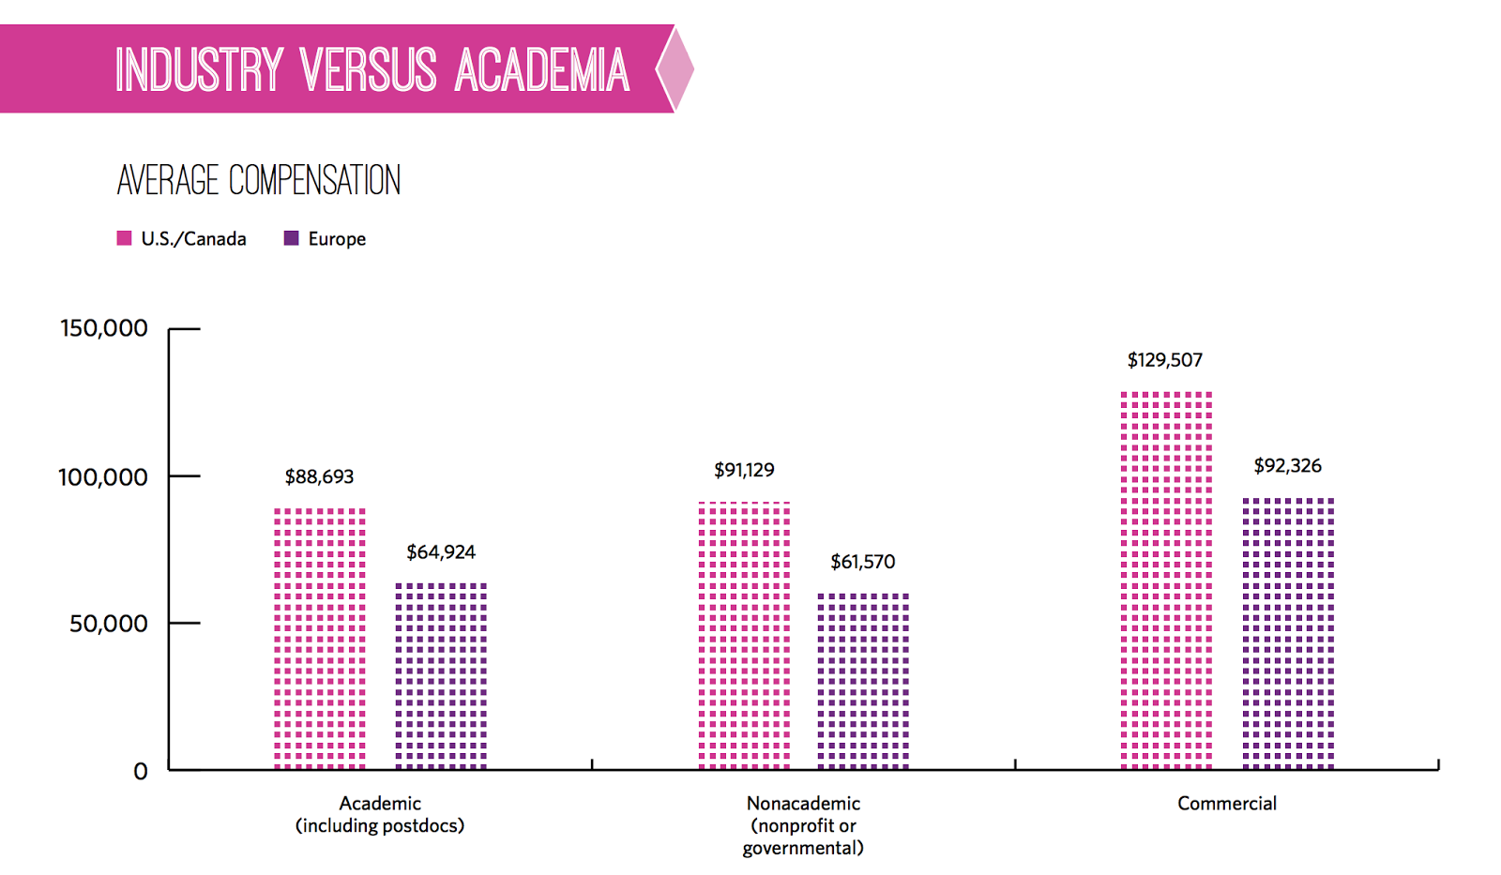
Average salaries

